Slide 1


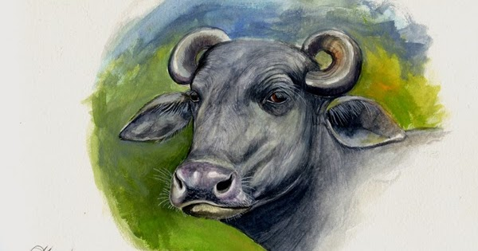
DEPARTMENT OF LIVESTOCK PRODUCTION MANAGEMENT MJF, JAIPUR
SEMINAR ON
REGISTERED BREEDS OF BUFFALO
Dr. Deepesh Garg Assistant Professor, LPM
1

Slide 2
INTRODUCTION
Buffalo milk is rich in fat content which usually range from 6 to 9 % (Bhadawari Milk fat % = 14 % (highest))
Therefore is more in demand for making butter and ghee and is priced higher than the cow milk
India ranks first position in Milk production in world
U.P. is the first and Rajasthan is 2nd in India in milk production

Slide 3
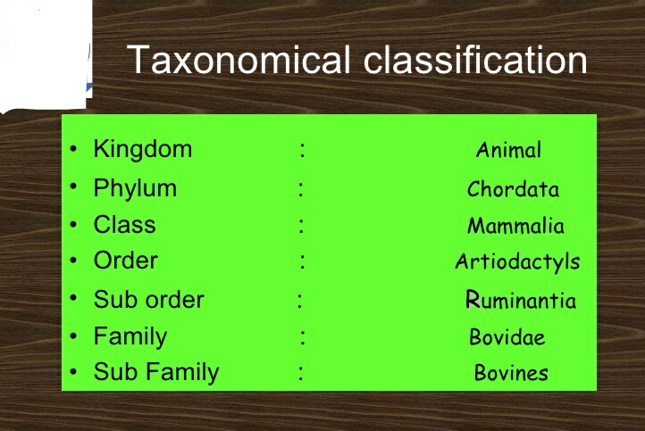
3

Slide 4
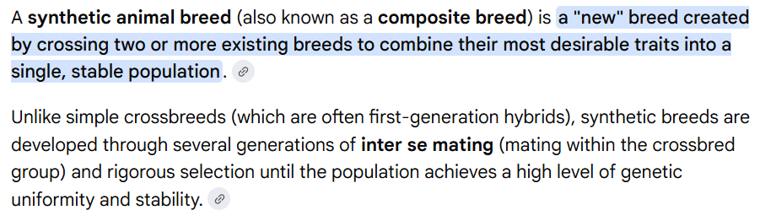
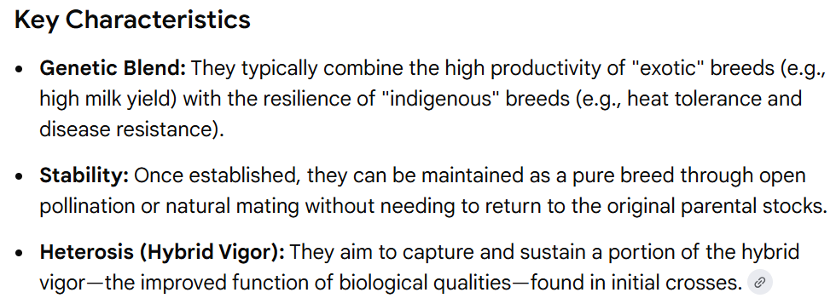

Slide 5
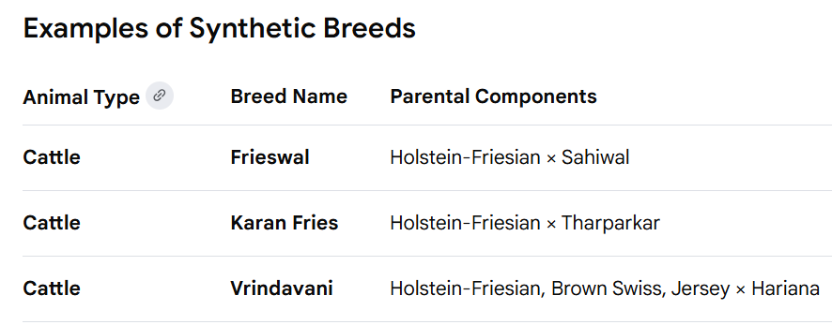
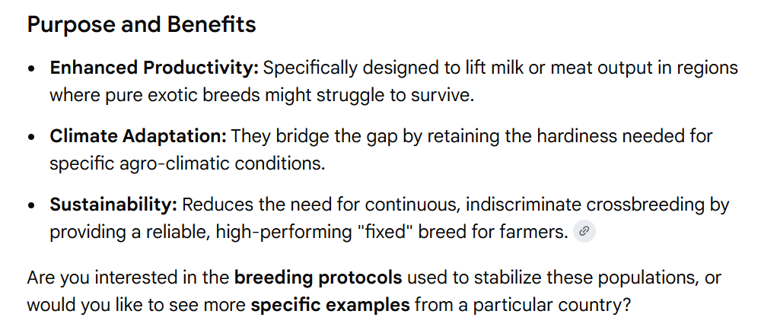

Slide 6
Classifaction of buffalo
.main two categories namely-
1.Raverine buffaloes
2.Swamp buffaloes
.The classification based on varation In
Their Habitat and Genome
.Riverine buffaloes are massive in size mostly with Cureld horns having 50 chromosomes
.Swamp buffaloes are stocky animals with marshy land habits And have 48 chromosomes.
4

Slide 7
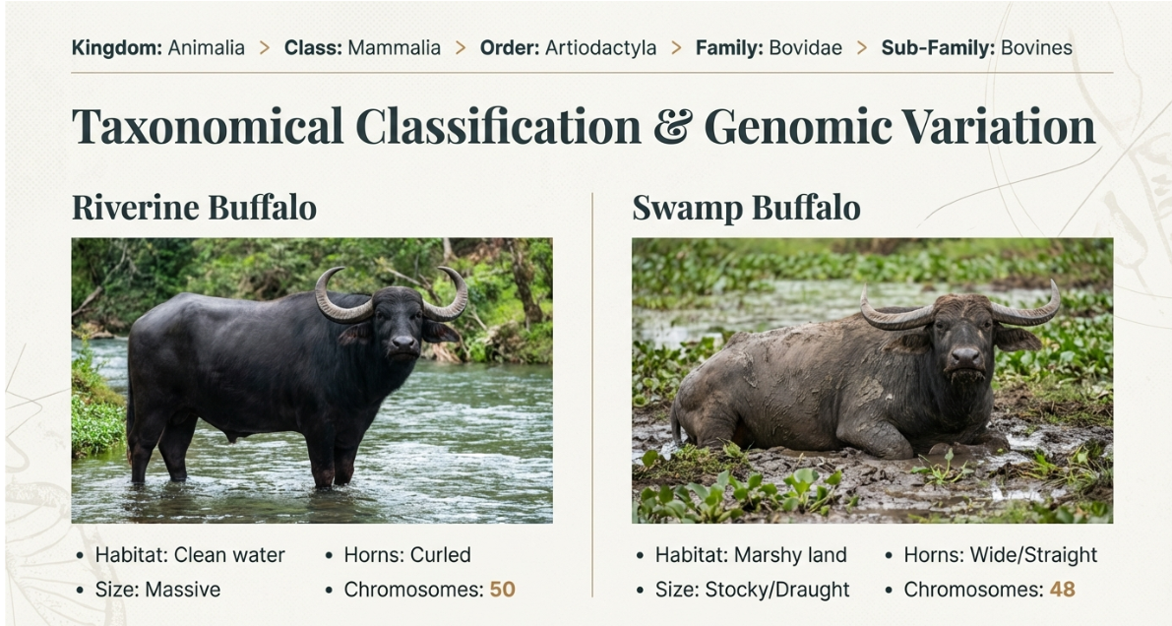

Slide 8
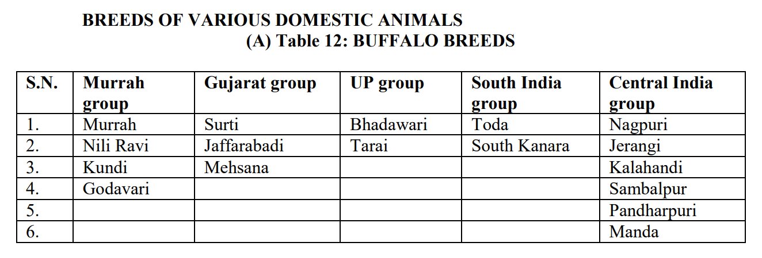

Slide 9
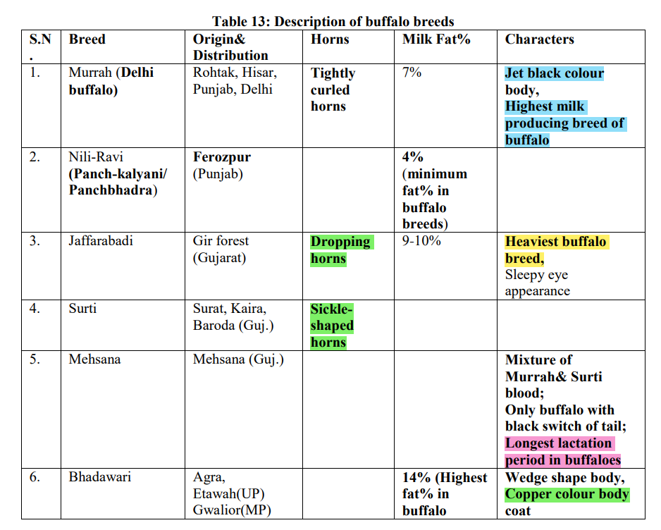

Slide 10
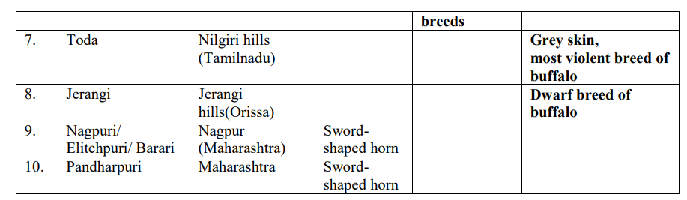

Slide 11
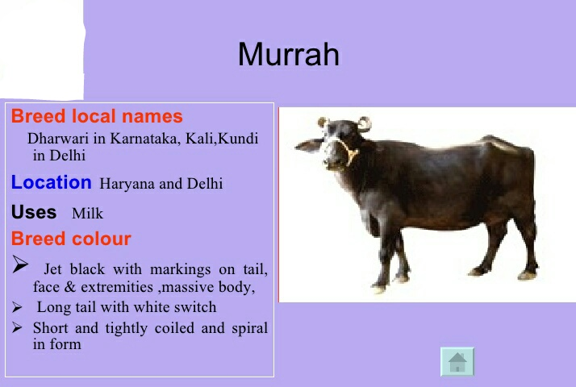
8

Slide 12
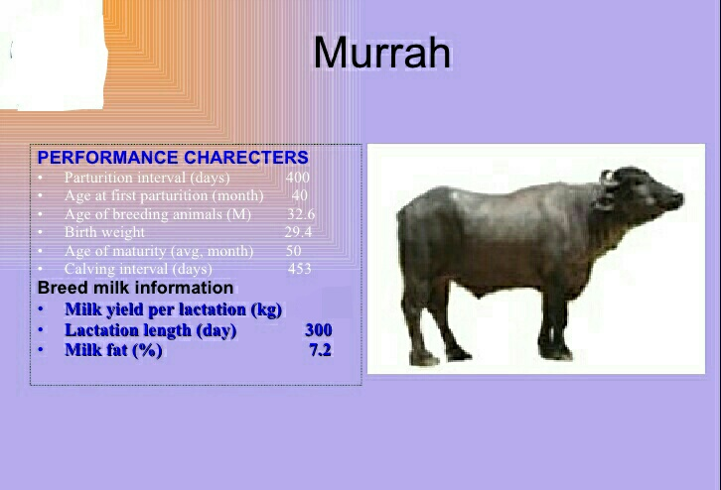
2275
9
9

Slide 13
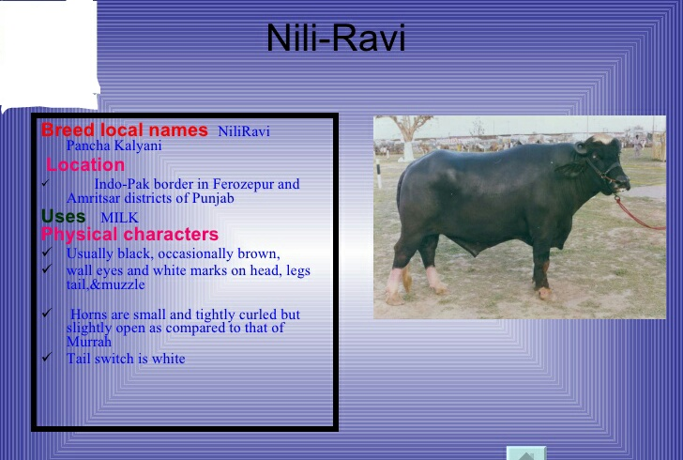
10

Slide 14
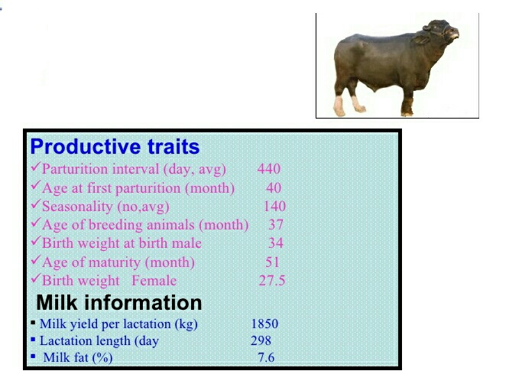
11

Slide 15
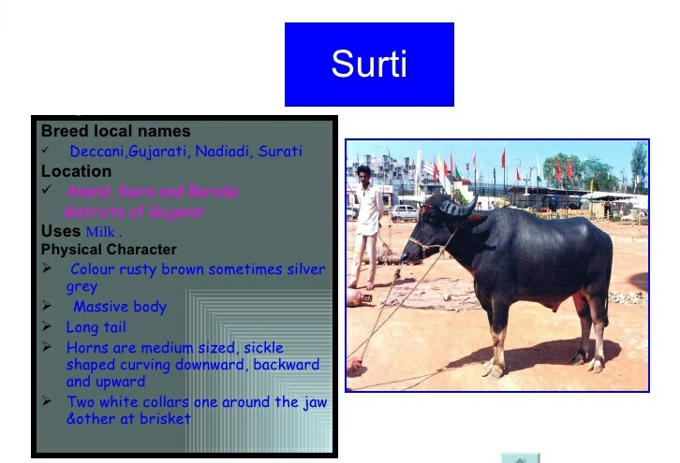
12

Slide 16
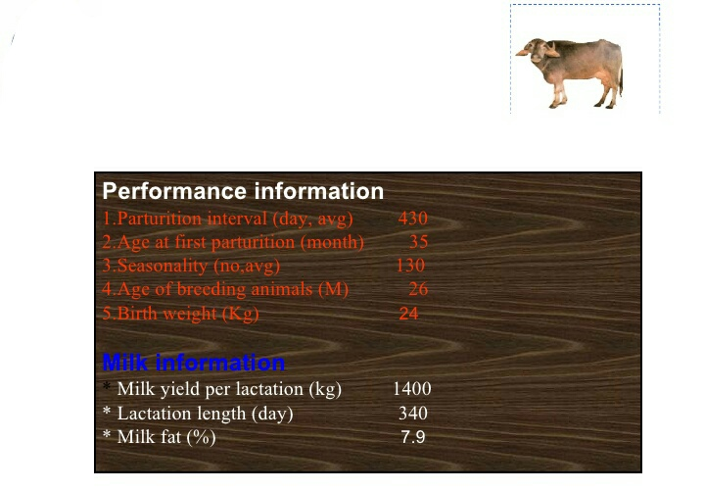
13

Slide 17
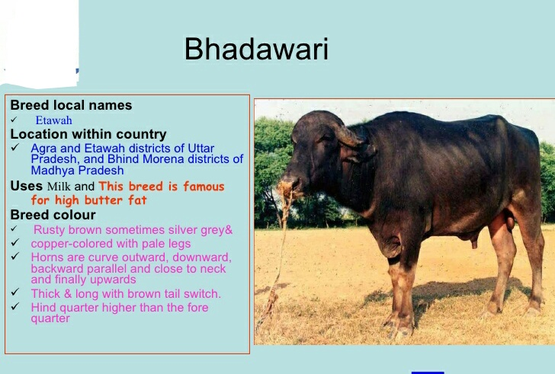
14

Slide 18
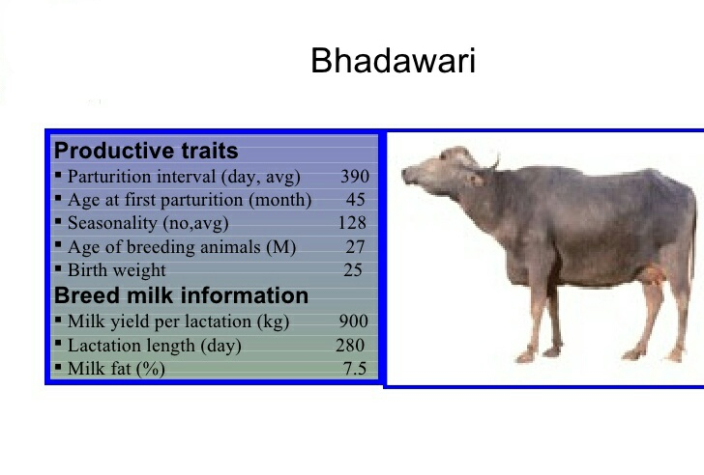
14
15

Slide 19
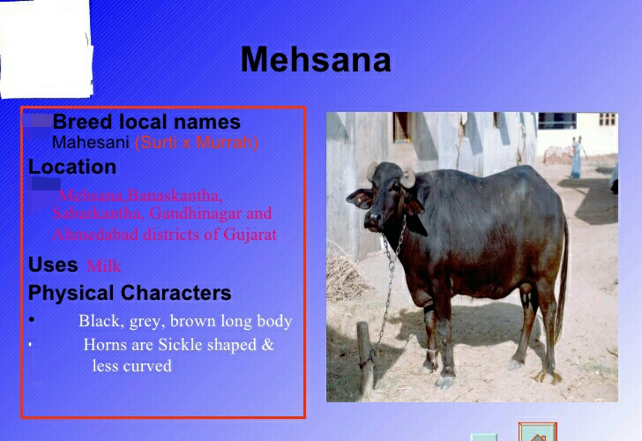
.
.
16

Slide 20
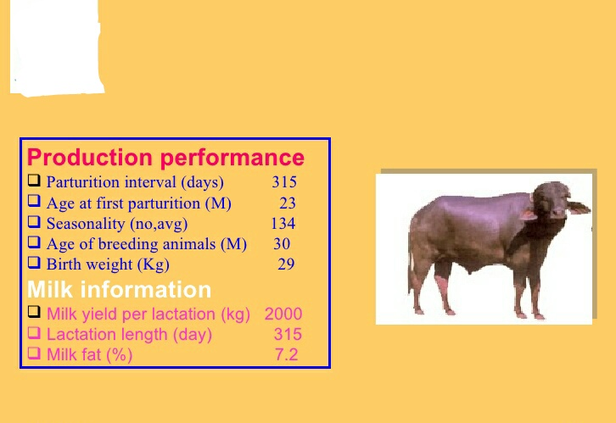
17

Slide 21
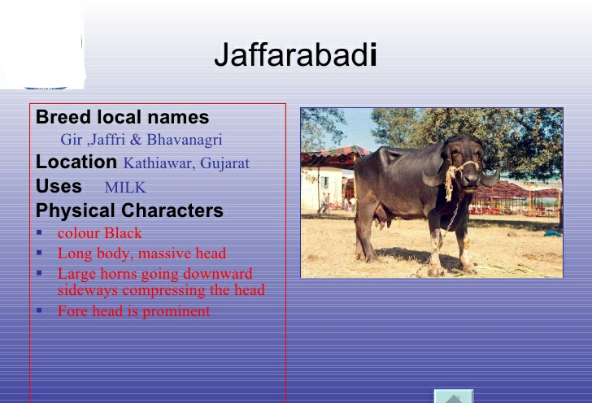
18

Slide 22
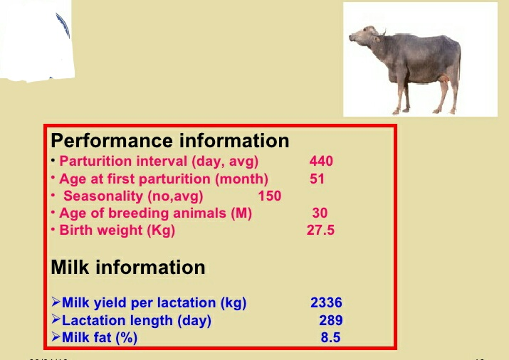
19

Slide 23
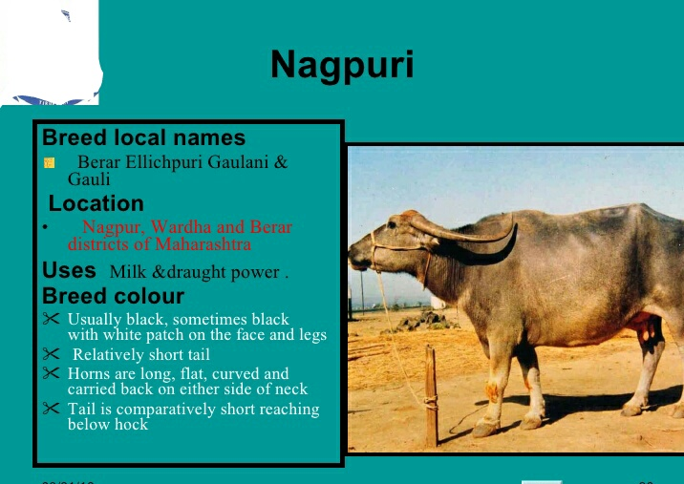
20

Slide 24
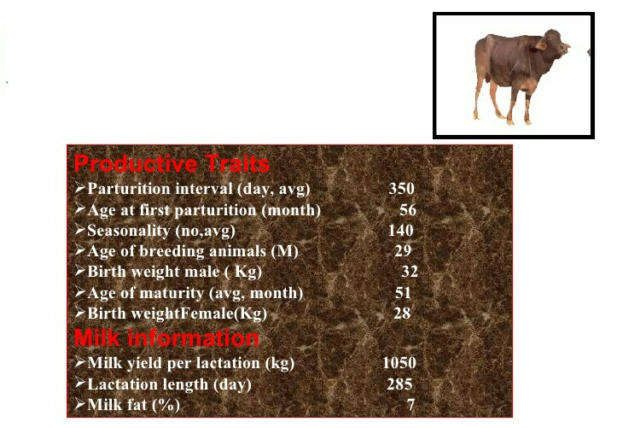
21

Slide 25
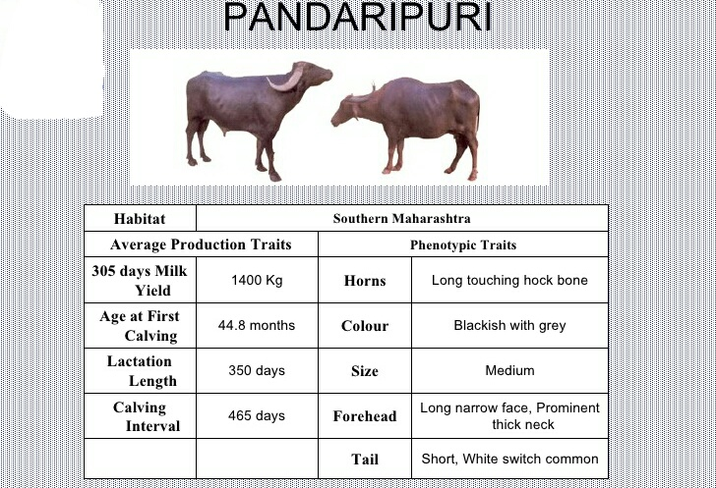
22

Slide 26
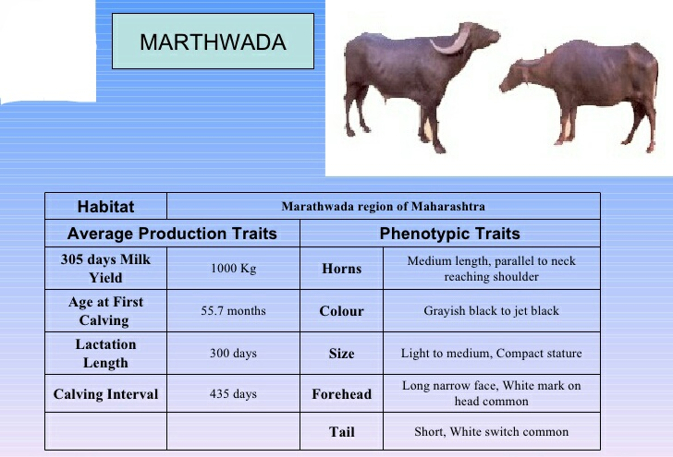
23

Slide 27
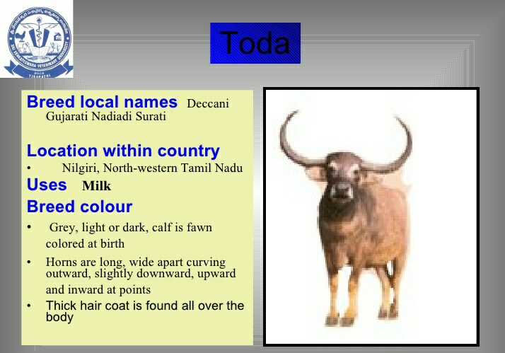
24

Slide 28
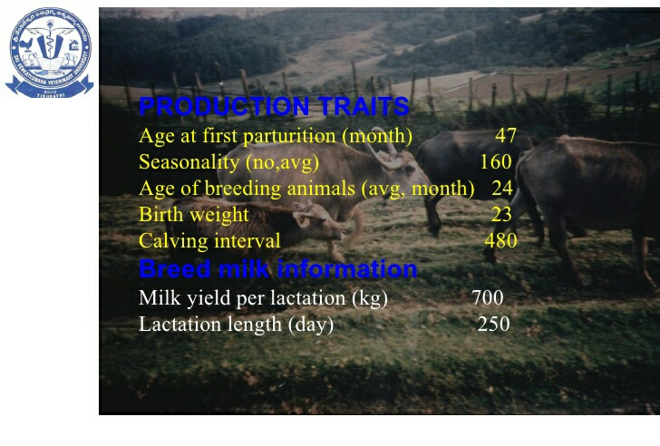
25

Slide 29
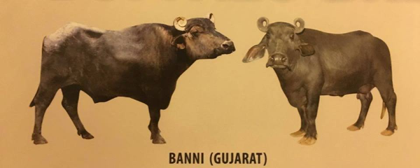
BANNI
Breed local name -kutchi or kundi
Location-kutchchha district of Gujarat
Uses-milk
Physical characters
-Body colour is mostly black some copper col.
-Fore head is elongated and straight
-Horns are tightly coiled vertically with single to double coiling
-Dewlop is absent
26

Slide 30
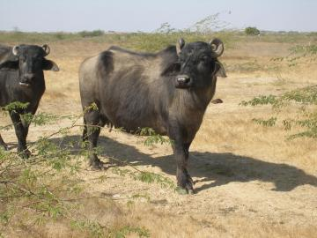
Productive traits-
-Calving interval (months)-12-14
-Age at first calving (years)-3-3.5
-Dry period (days)-71
-Service period(days)-60-70
Milk information
-Milk yield per lactation (kg)-2500-2700
-Lactation length day-290-295
-Milk fat % -7-8
27

Slide 31
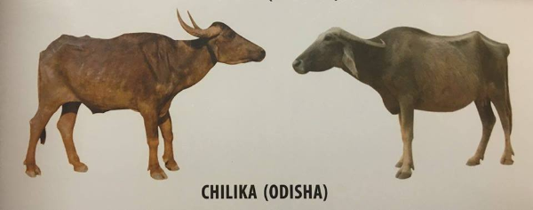
CHILIKA
Breed local names- Desi
Location-Cuttack Ganjam puri and khurda district of Odisha
Uses-milk manure and draught
Physical characters-
Body colour is brownish black or blck
Horns are black straight curved upward and inward
Body size is small and compect
28

Slide 32
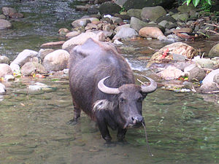
Productive traits-
Calving interval(months)- 14
Age at first calving(years)-3.5
Service period(days)- 116
Productive traits-
Milk yield per lactation(kg)- 440-500
Lactation length (days)- 234
Milk fat % -8.5-8.8
29

Slide 33
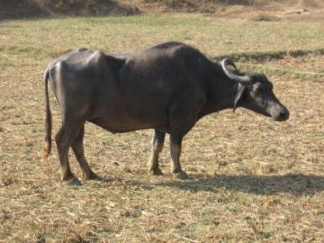
KALAHANDI
Breed local name.-Deshi
Location-Kalahandi and Rayagada district of odisha
Uses-Milk,Cultivation and transporation
Physical characters-
-Body colour is Gray,black gray,ash gray
-Horn broad and half corved runing back ward at tips
-Body large strong with massive body
30

Slide 34
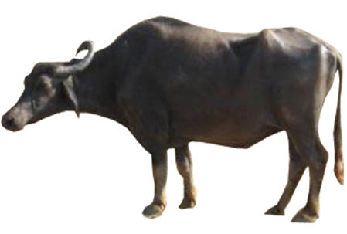
Productive traits-
-Age of puberty(years)- 3.15
-Age of first calving(years) - 4.14
-Calving interval(months)- 17
-Service period(month)- 7.4
Milk information-
-Milk yield per lactation(kg)- 680-912
-Lactation length (days)- 276
-Milk fat %- 7-8.6
31

Slide 35
CONCLUSION
-Milk yield per laction is highest in murrah
-Bhadawri milk highest fat contant 14 %
-Toda thick hair coat is found all over the body
-Jaffarabadi is the heaviest and massive body
-The chilika buffalo are endowed with the unique quality of entering deep into the salty water of the lack
-Mehsana is the cross of surti and murrah
32

Slide 36
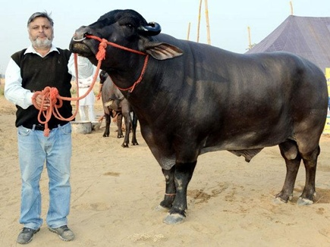
Thank you
THANK YOU
33
33

