Slide 1
Department of Livestock Production Management
MJF, CHOMU, JAIPUR
Soil Moisture Conservation For Fodder Production
Dr. Deepesh Garg Assistant Professor

Slide 2
OVERVIEW :-
Soil moisture
Soil conservation techniques .
Soil moisture conservation techniques .
References .

Slide 3
World Soil Day
5 December
Soil moisture conservation institution in India:-
ICAR-Indian Institute of Soil and Water Conservation , Dehradun .

Slide 4
Effective soil and water management practices can improve soil fertility and increase yields in a sustainable way.
There are some techniques that conserve soil and water, preserve soil moisture and/or drain water sustainably to avoid soil erosion, land sliding and depletion of soil nutrients.
i. Soil moisture conservation techniques: Terraces, Contour bunds, Broad beds and furrows, Semi-circular bunds, Trash lines, Diversion ditches and cut-off drains, Retention ditches, Pitting, Trenches, Tied ridges, Grass strips, Irrigation.

Slide 5
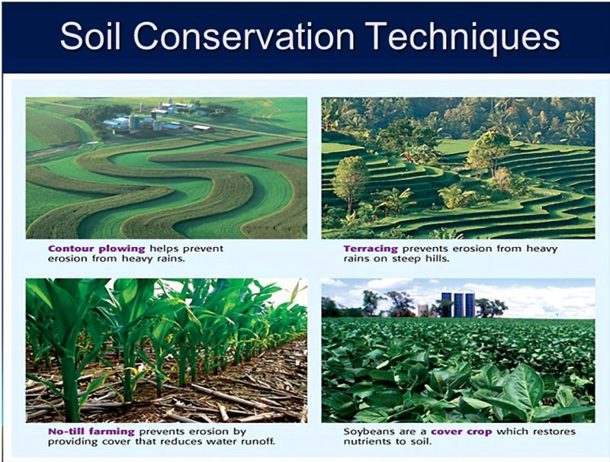

Slide 6
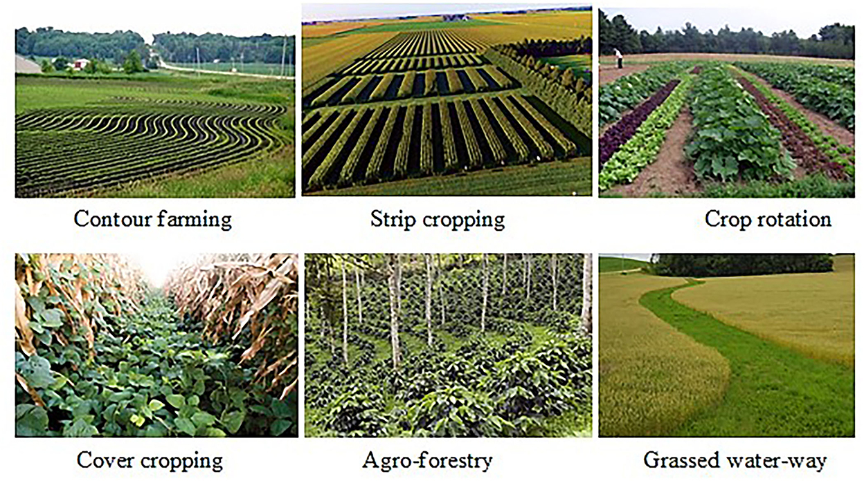

Slide 7
ii. Rain water harvesting techniques: Roof catchment, Ground surfaces and rocks, Irregular surfaces.
iii. Water storage techniques: Tanks,, Ponds, Dams, Wells and boreholes.
iv. Sustainable sanitation systems: Ecological sanitation, Kitchen water

Slide 8
Soil conservation:- It is the prevention and reduction of the amount of soil lost through erosion. It seeks to increase the amount of water seeping into the soil, reducing the speed and amount of water running off. Erosion is prevented by keeping enough vegetation to protect the soil surface and binds the soil together and maintains soil structure.
Water conservation:- This is a way of tapping as much water as possible and storing it in tanks or reservoirs. It allows water to sink into the soil increasing soil moisture levels.

Slide 9
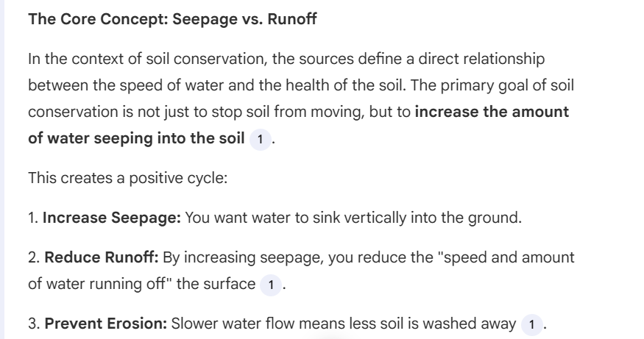

Slide 10
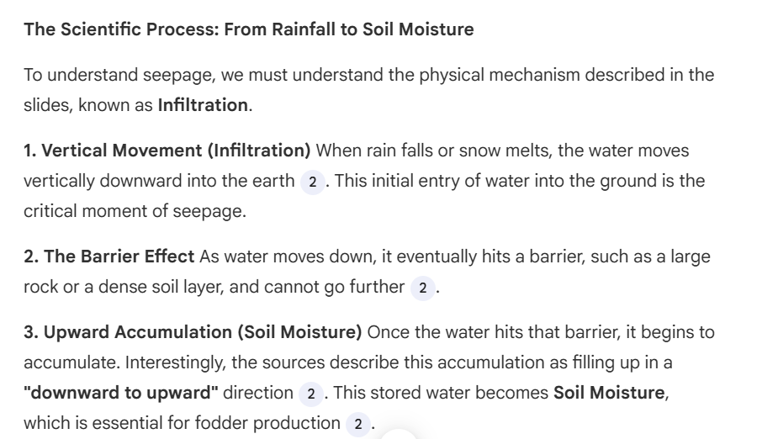

Slide 11
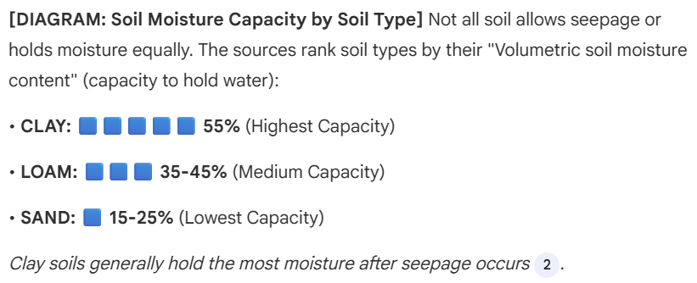

Slide 12
Benefits of soil and water conservation
➤ Conserving water makes it available for crops, livestock and domestic use over a longer period.
➤ Controlling soil erosion improves crop and pasture yields.
➤ Conservation measures improve the supply of fuel.
➤They increase the value of the land.
➤ More and better livestock fodder is available.

Slide 13
SOIL MOISTURE:-
After rain fall or snow melting ,water goes to vertically downward in soil ,this process is called as infiltration .
When a big rock is come in its pathway , it does not go further.
This process repeats many times and thus water accumulates in direction from downward to upward.
This accumulate water is called ‘soil moisture’.

Slide 14
Soil moisture in various types of soil :-
Clay > Silt > Sand
Soil moisture
Type of soil | Volumetric soil moisture content remaining at field capacity in %
Clay | 55
Loam | 35 - 45
Sandy | 15 - 25

Slide 15
Clay Soil
Particle size: Very fine particles (less than 0.002 mm)
Characteristics:
Heavy and dense texture
Sticks together when wet, forms clumps
Very slow drainage - holds water for long periods
Poor aeration (roots can struggle to breathe)
Rich in nutrients (holds them well)
Slow to warm up in spring
Hard and cracked when dry
Difficult to work with
Best for: Crops that tolerate wet conditions like rice,
some vegetables in managed conditions.
Improves with organic matter addition.
Sandy Soil
Particle size: Large particles (0.05-2 mm)
Characteristics:
Light and gritty texture
Loose and doesn't clump together
Excellent drainage - water passes through quickly
Good aeration
Low nutrient retention (nutrients wash away easily)
Warms up quickly in spring
Easy to work with
Prone to drying out
Best for: Root vegetables (carrots, potatoes), drought-tolerant plants, crops preferring well-drained soil. Needs frequent fertilization and watering.
Loam Soil
Particle size: Balanced mixture of sand (40%), silt (40%), and clay (20%)
Characteristics:
Medium texture - crumbly and slightly sticky
Moderate drainage (not too fast, not too slow)
Good aeration
Excellent nutrient retention
Retains moisture well but doesn't waterlog
Easy to work with
Warms moderately in spring
Holds structure well
Best for: Almost all crops - it's considered the ideal "garden soil." Supports vegetables, fruits, flowers, grains, and most agricultural crops.

Slide 16
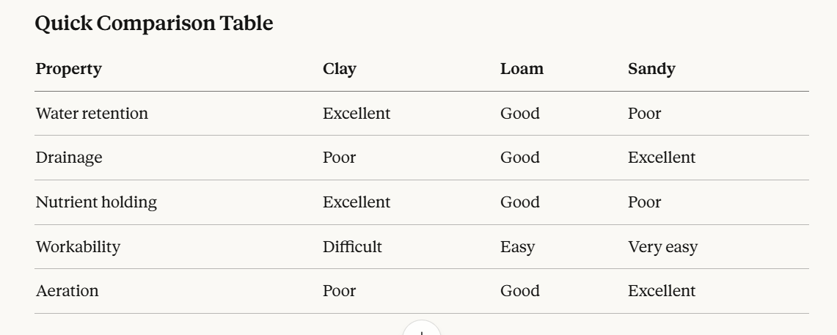
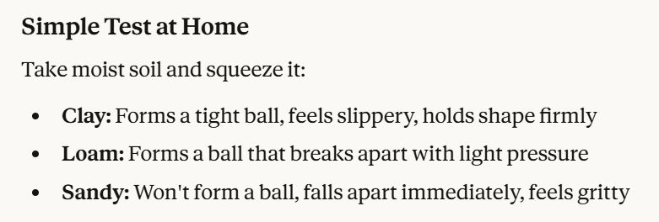

Slide 17
WHY SOIL IS CONSERVED :-
Because some factors destroy quality and quantity of soil –
Soil erosion.
Imbalanced use of chemicals.
Some other reasons :
When soil is protected ,it helps plants create more nutrients our bodies need ,like protein .
The billions of microbes living in healthy soil produce amino acids ,which plants convert to protein .

Slide 18
1
Agronomic
2
Physical
3 & 4
Biological
Chemical
Types of
conservation measure

Slide 19
Agronomic conservation measures
Crop management :-
Crop selection :-
Early planting:-
Cover cropping :-
Good crop management reduces soil erosion . It improves soil fertility.
Perennial crops are more effective in soil conservation than annual crops. eg-Tea, Fodder grasses, sugarcane and Sweet potatoes.
This ensures that the crop shoots from the ground within one or two weeks after the onset of the rains & protects the ground against raindrop impact.
It protects the soil from excessive heat and creates a good environment for microorganisms
The fallen leaves of the cover crop decompose and add organic matter to the soil.

Slide 20
Cont..
Crop rotation :-
Inter-cropping :-
Strip cropping:-
Soil management:-
Crop rotation ensures the addition of humus ,soil fertility , control of erosion and reduction of pests and diseases.
Fast growing legumes such as beans and cowpeas provide soil cover early in the season before maize or cotton develop a canopy to shield the soil from impact of raindrops .
This is growing alternate strips of different crops in the same field .It controls water and wind erosion.
Soil management is to create optimum conditions for plant growth through improved soil fertility and structure. It increases infiltration rates, improve water holding capacity ,and reduce runoff and erosion.

Slide 21
Cont.
Use of appropriate tillage practices :-
Tillage is the preparation of land for growing crops.The main tillage methods are slash and burn,hand hoeing, ploughing and harrowing ,conservation or minimum tillage,deep tillage.
Agro –forestry:-
Agro forestry involves planting trees or shrubs,or keeping those that are already there-
Trees cushion the impact of raindrops on the soil,so reducing the amount of rain-splash erosion.
They shade the soil ,reducing the soil temperature and cutting the amount of water that would evaporate into the air.
They break the wind ,reducing the amount of wind erosion.
They recycle nutrients from deep in the soil;leguminous trees fix nitrogen that benefits food crops.

Slide 22
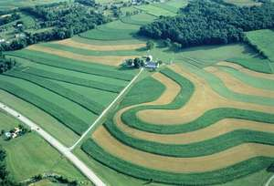
Cont.
Contour farming practices :-
Contour ridges are used in semi –arid areas to harvest water and in higher rainfall areas for growing potatoes.
Trash- lines are constructed by laying plant residues in lines along the contour.

Slide 23
Biological soil moisture conservation measures:-
Chemical soil moisture conservation measures :-
Hydrogel.
Mulching
Use of organic manure
Use of earthworms
Reforestation

Slide 24
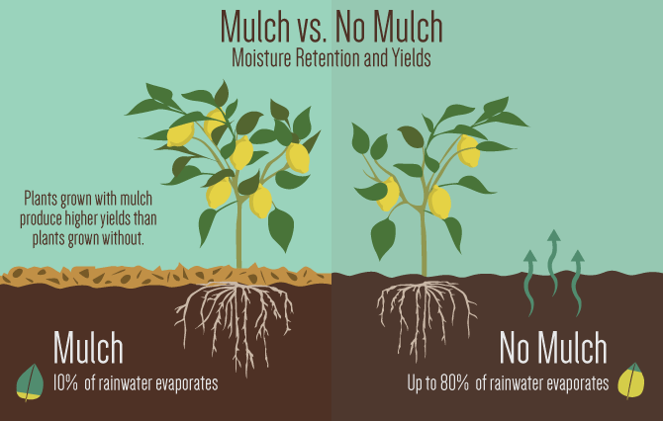

Slide 25
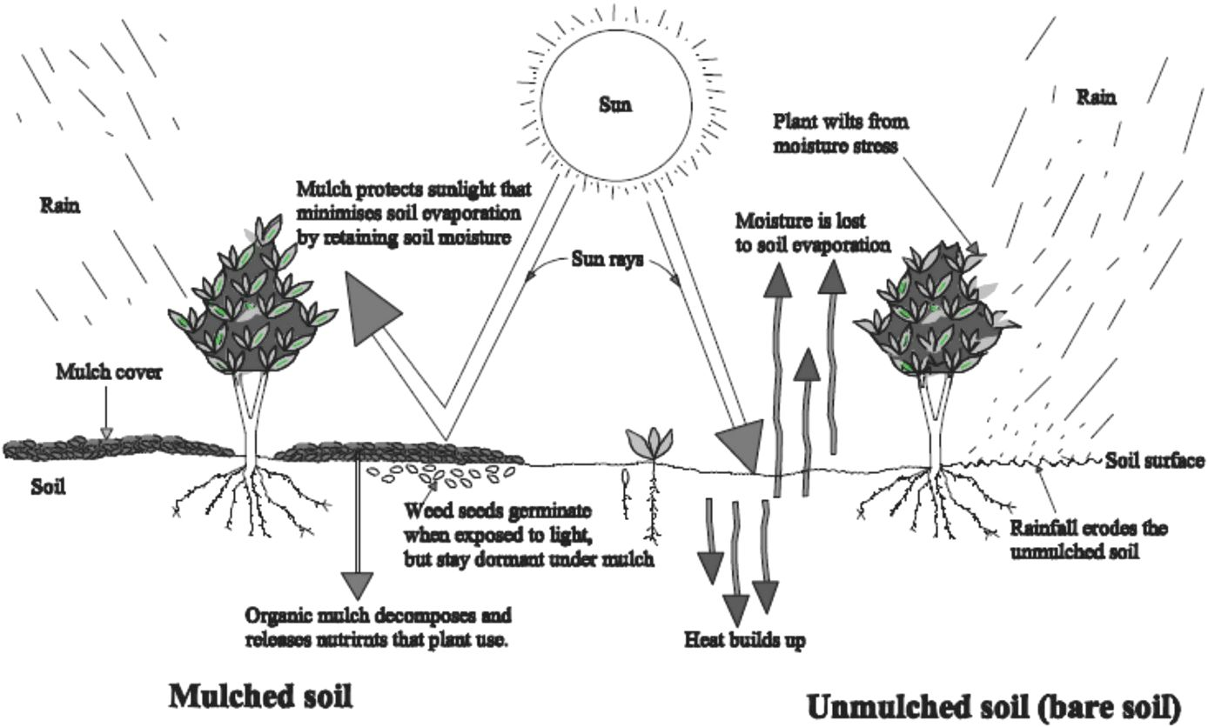

Slide 26
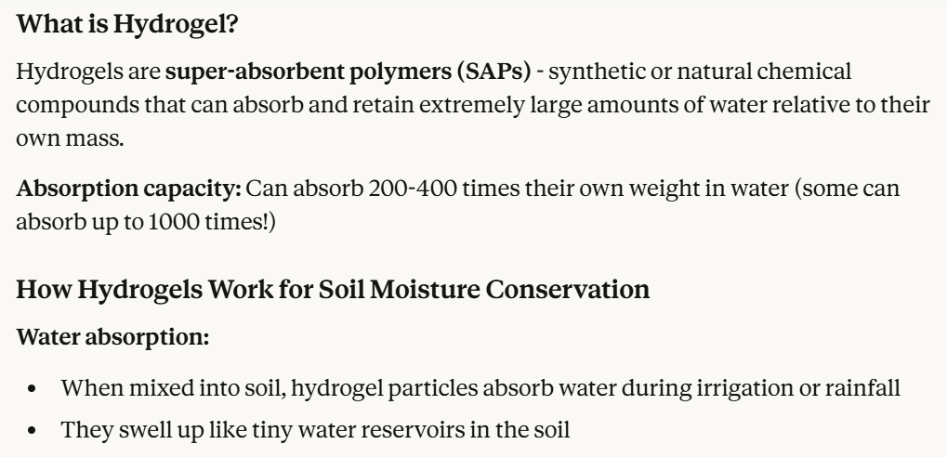
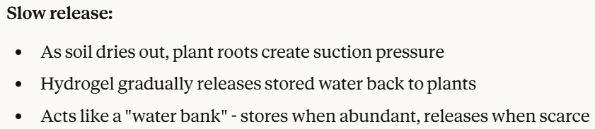
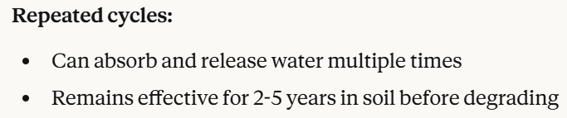

Slide 27
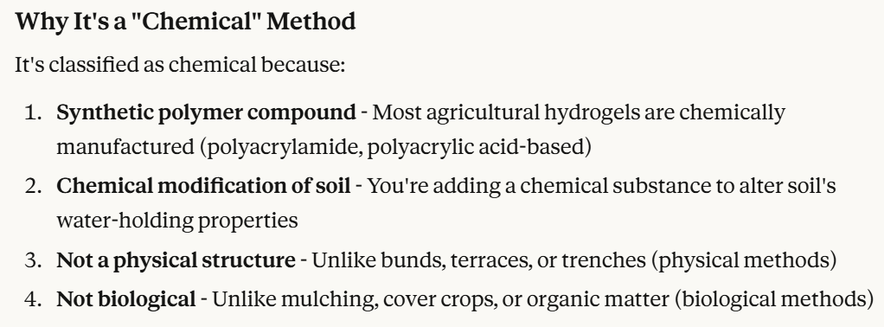
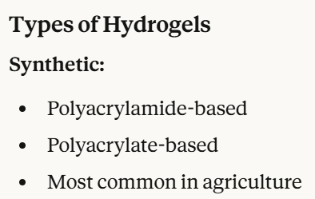

Slide 28
ThankYou

